Slide 1
RICe
Radio Frequency Identification Inventory Control System
Srin Balusu
Brock Burdyl
Wenyi Zou

Slide 2
Agenda
Overview
Microcontroller
RFID Protocols
Antenna
Matching Circuit
Software
User Interface
Conclusion

Slide 3
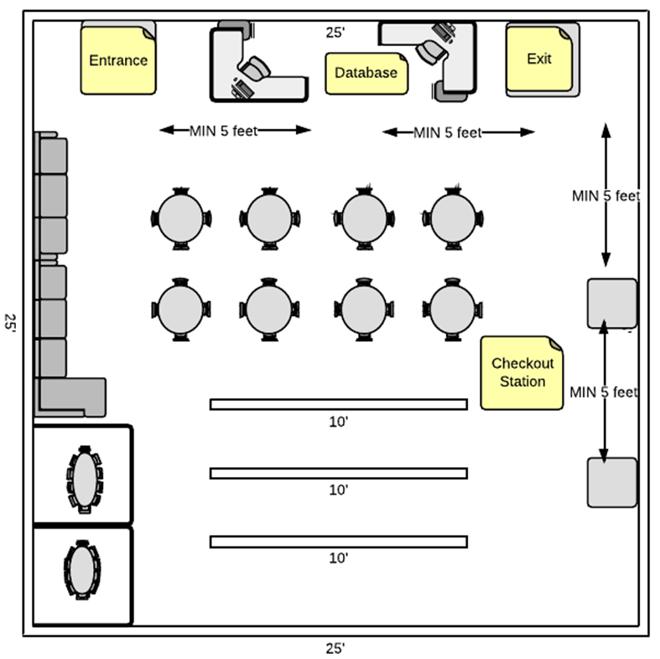
Overview
Mission Statement
Introduction

Slide 4
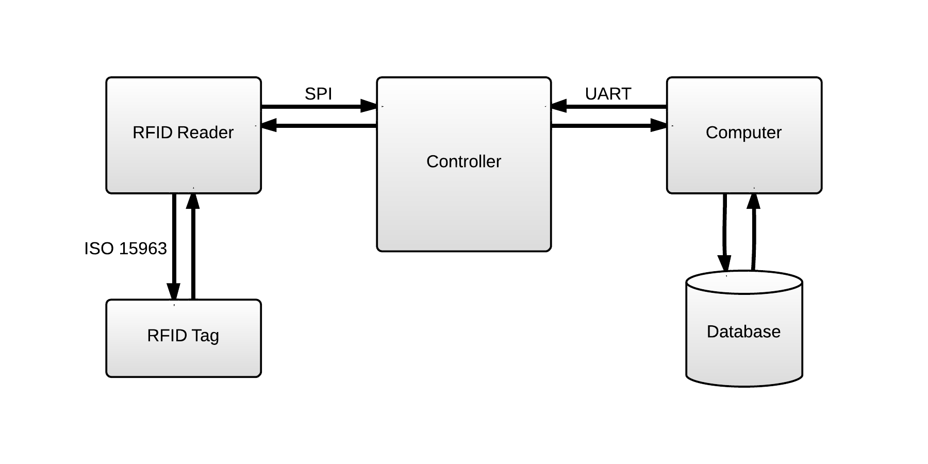
System Diagram

Slide 5
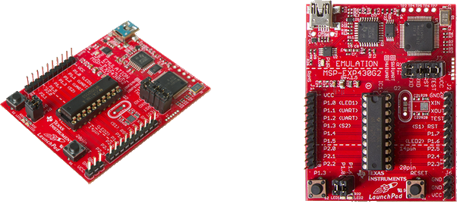
Microcontroller
MSP430G2553 Features
16MHz
16KB Flash
512B RAM
8ch 10-bit ADC
Comparator
2 16-bit Timers
Up to 1 I2C, 2 SPI, 1 UART
ONLY $ 9.99

Slide 6
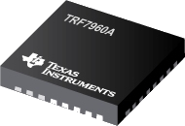
RFID chip
TRF7960A Features
Support ISO 15693
Programmable output power
SPI protocol communication
13.56 Mhz
Low power consumption
FREE sample

Slide 7
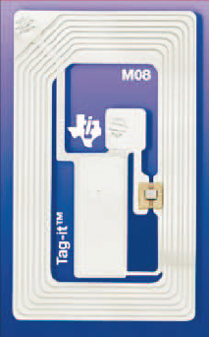
RFID tag
RI-I02-114A-S1 Features
ISO 15693
13.56-MHz Operating Frequency
256-Bit User Memory in 8-Bit × 32-Bit Blocks
Fast Simultaneous Identification (Anti-Collision)
Password Protected Write Command

Slide 8
ISO 15693
Standard protocol for 13.56Mhz RFID communication.
6.62 Kbit/s to 26.48 Kbit/s.
Reading range up to 1- 1.5 meters.
Low power needed.
Widely used in passive RFID tag.

Slide 9
Transmitting Signal
Data
256-Bit User Memory, 1 byte each time
item: store the information of checking out status and item number.
patron: store the information of patron ID
Command
1byte command code, 1 byte each time
tag select,read,write,change password

Slide 10
Connection

Slide 11
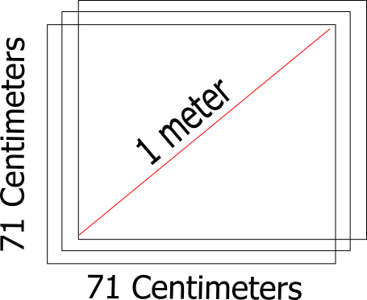
Antenna Design

Slide 12
Antenna Explaination
13.56 MHz Better Penetration (Low Frequency RFID)
Small Square Antenna Rule of Thumb:
Range = Diagonal and Bigger=Better
Inductance calculated using Joe Carr formula
An RLC Circuit can be used to model the antenna

Slide 13
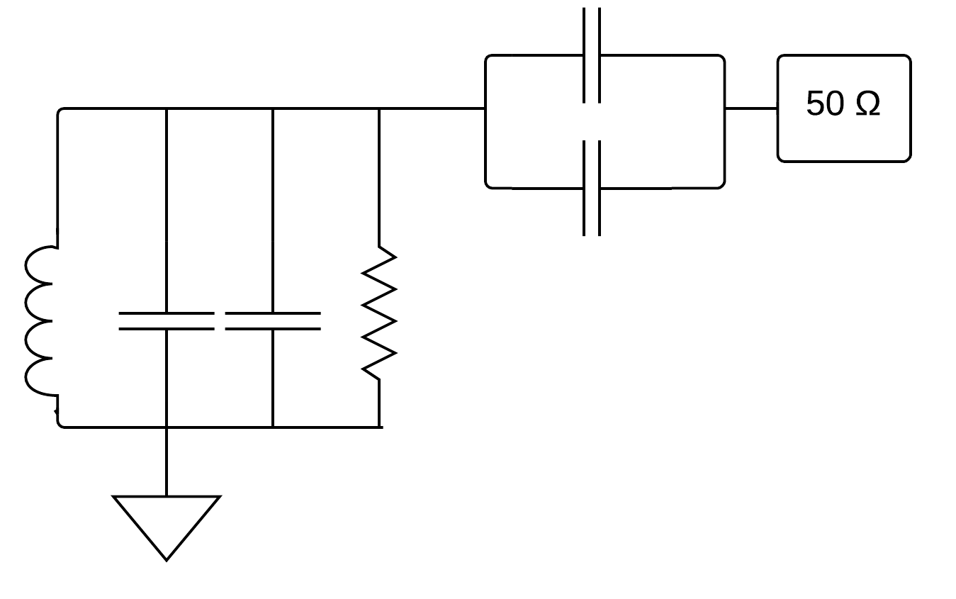
Antenna Circuit
Variable capacitors have been used to increase the robustness of the circuit for the resonant frequency

Slide 14
Matching Circuit
Purpose #1: The matching circuit matches impedances to allow for maximum power transfer. Otherwise power will be reflected back to the source and not out from an antenna.

Slide 15


Matching Circuit
Purpose #2: The RFID Chip only produces 200 mV. We need more power to increase range of antenna. By increasing the voltage we can increase the average power radiated.

Slide 16
Matching Circuit
Purpose #3: Since we are using a power amplifier, we need to protect the RFID Chip. Maximum received voltage levels are 3.5V. We are planning to design the system to send voltage inputs of 3V.

Slide 17

Matching Circuit
This makes for an interesting design because transmit and receive paths are on the same circuit because the antenna connects with both paths at the same node. Recall:

Slide 18
Antenna Circuit
Variable capacitors have been used to increase the robustness of the circuit for the resonant frequency

Slide 19
Matching Circuit
N(number of turns) | l(coil length in centimeters) | s(side length in centimeters) | L(uH) | Cmatching(pF)
1 | 284 | 71 | 0.745751 | ~224
2 | 568 | 71 | 5.09082 | 69. 4863
2 | 662 | 71 | 6.24673 | 64.476
3 | 852 | 71 | 16.799 | 50.6264
4 | 1136 | 71 | 39.9531 | 45. 8743

Slide 20
Matching Circuit
Purpose #1: The matching circuit matches impedances to allow for maximum power transfer. Otherwise power will be reflected back to the source and not out from an antenna.

Slide 21
Matching Circuit
Purpose #2: The RFID Chip only produces 200 mV. We need more power to increase range of antenna. By increasing the voltage we can increase the average power radiated.

Slide 22
Matching Circuit
Purpose #3: Since we are using a power amplifier, we need to protect the RFID Chip. Maximum received voltage levels are 3.5V. We are planning to design the system to send voltage inputs of 3V.

Slide 23
Matching Circuit
This makes for an interesting design because transmit and receive paths are on the same circuit because the antenna connects with both paths at the same node. Recall:

Slide 24
Matching Circuit Design
Will use a Class C amplifier that will activate when a modulated AM signal turns it on and will resonate at the output frequency selected.
While the RFID Chip is transmitting, the receiving blocks are held in reset.
On return signal from passive RFID Tag having been activated by a transmission, the antenna will feed signal back on path while transmitter is off.

Slide 25
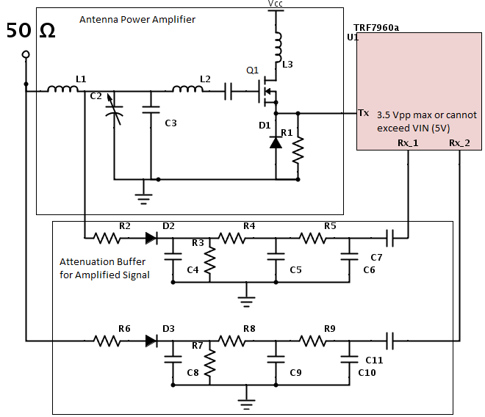
Matching Circuit Design
We do not have a finalized design for our matching circuit
The power amplifier is close.
The attenuation can either utilize resistive voltage dividers or capacitive voltage dividers and may/or may not use external low pass filters as depicted here

Slide 26
Testing
Crawl-Walk-Run: We need to be able to know that we can send and receive accurate data before we add our matching circuit into the system.
Once we have the software working, then we can see if our antenna causes a signal return at any range. Then we can tune variable capacitors to improve the signal via impedance matching. Then we can increase the power. If this fails, then we have to build a bigger antenna.

Slide 27
Application
Chrome app
Cross platform
Ease of development
Fast UI iteration

Slide 28
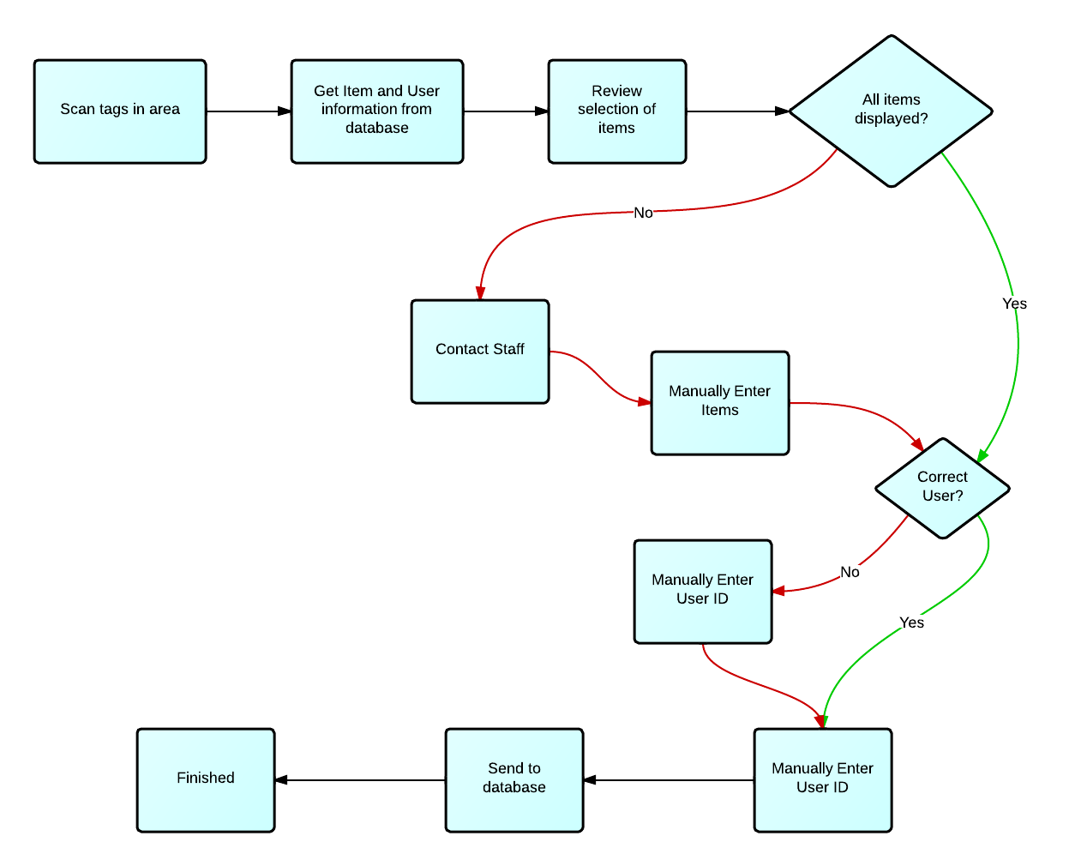

Slide 29
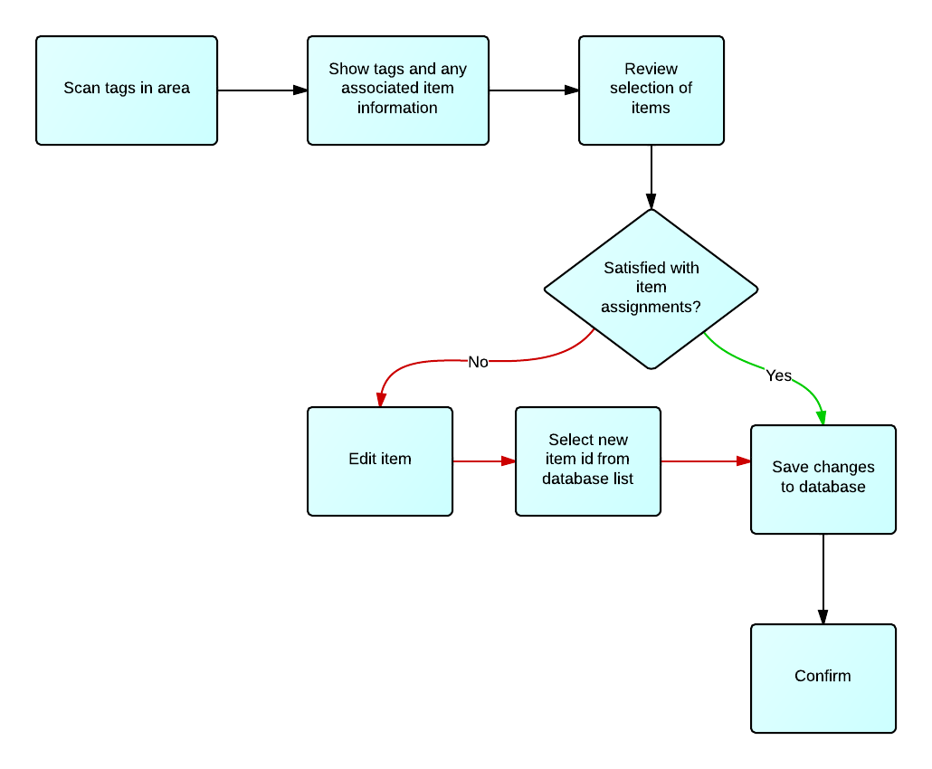

Slide 30
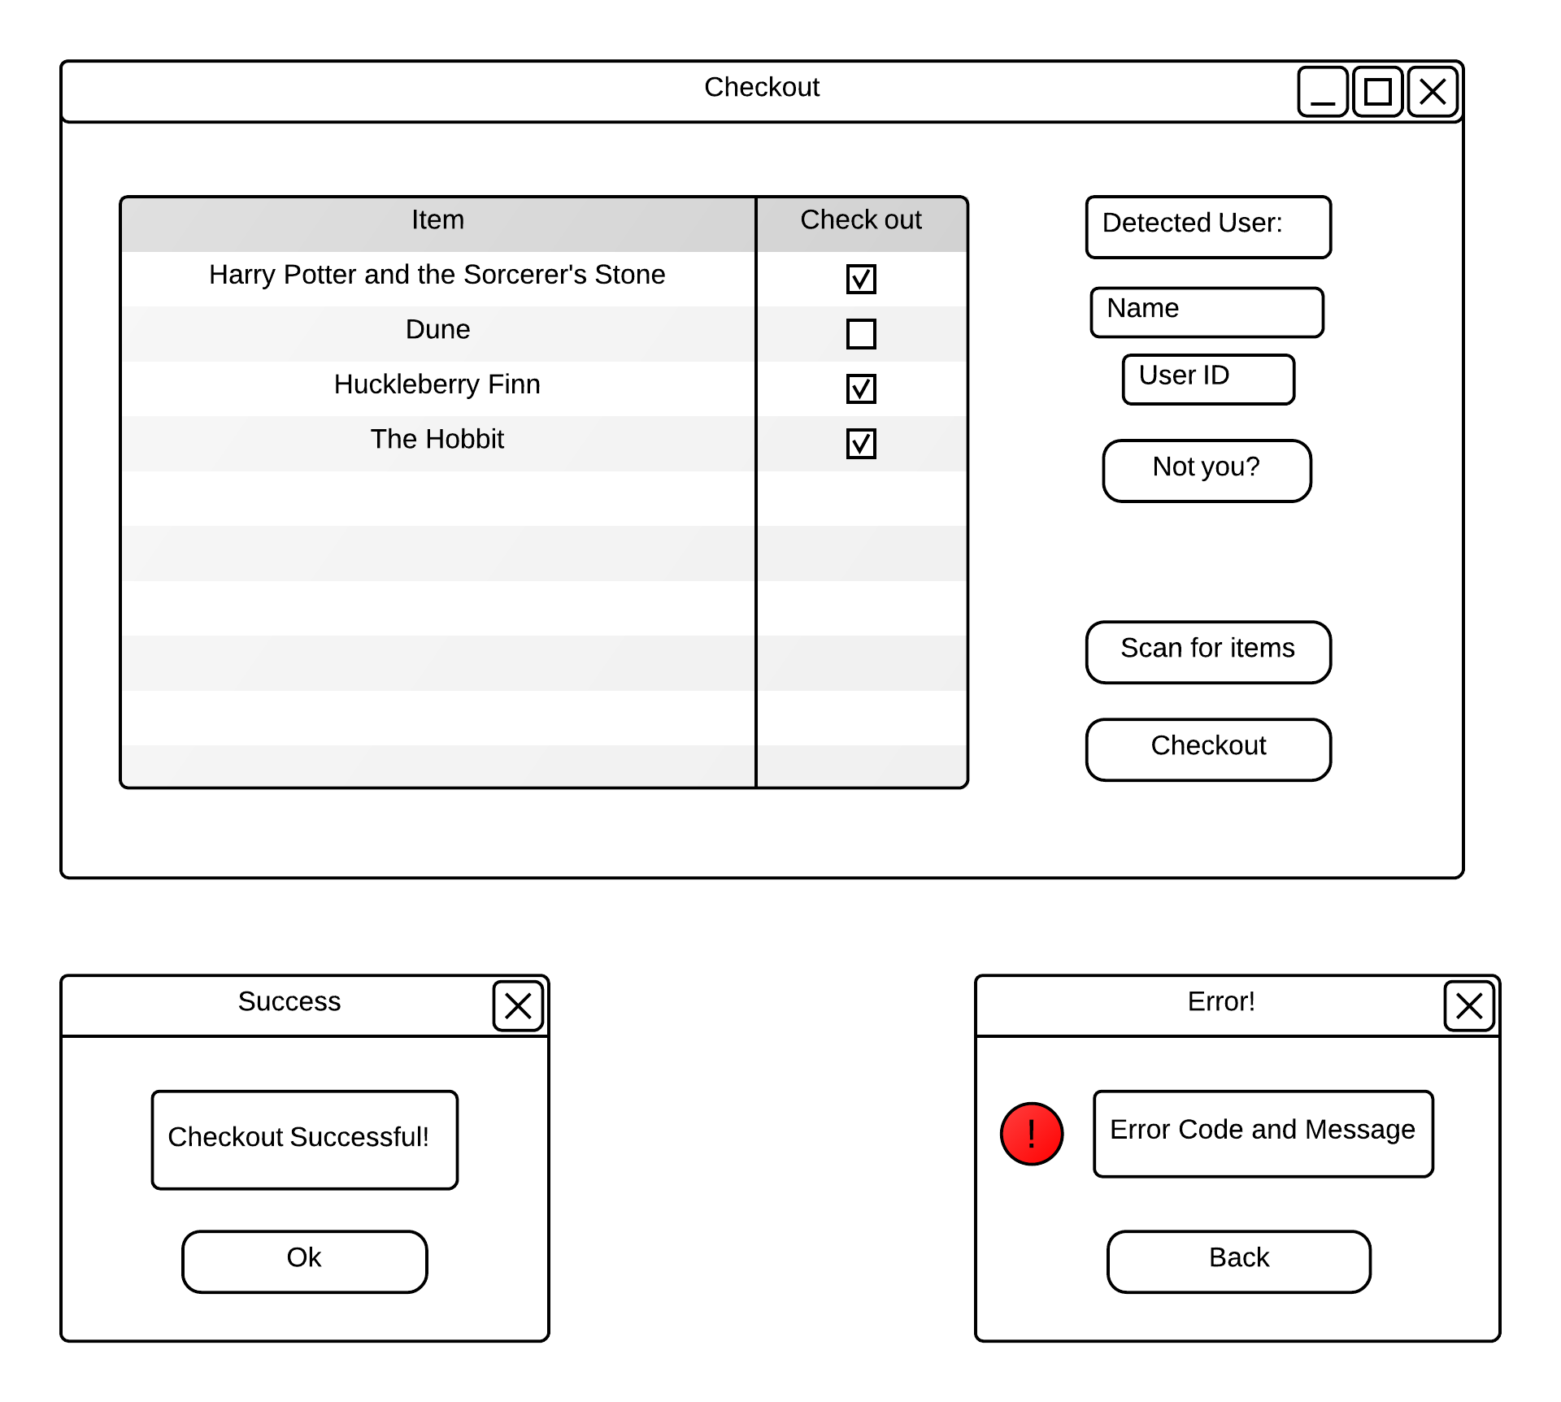

Slide 31
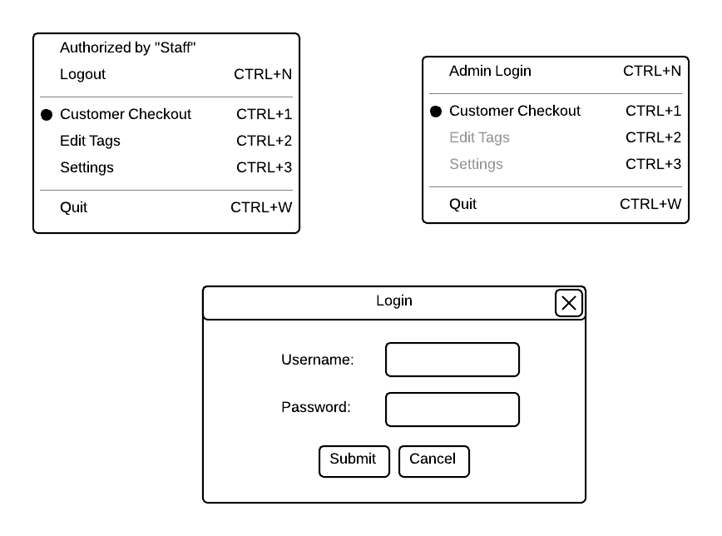
Application
Easily switch between user and admin

Slide 32
Application
Database
Rest Interface
Any database software that implements a few functions
  Insert, Update, Get, Delete

Slide 33
Future Steps
Task | Timeline
Antenna and matching circuit | Weeks 1-3
Controller and rfid reader communications | Week 1-3
Computer and Controller communications | Week 4
Application development | Weeks 1-4
Database communication | Week 5
Testing and completing design | Weeks 5-7
Additional settings and configuration options | Weeks 8-10

Slide 34
Parts list and budget
Component | Price | Quantity | Cost | comment
Microcontroller | 10 | 3 | 30 | Use TI product MSP430G2553 Launchpad
RFID chip | 0 | 3 | 0 | Use TI product TRF7960A, free samples
32-pin QVN to DIP board | 13.5 | 3 | 40.5 | Used for TRF7960A pin expansion, shipping fee included
RFID tags | 0.608 | 10 | 6.08 | Use TI product RI-I03-114A-S1
Circuit board | 0 | 3 | 0 | Get from Northwestern University
Electrical components | 0 | many | 0 | Get from Northwestern University, include resister, inductor, capacitor, wire etc.
Testing board | 49 | 1 | 49 | Use T I product TRF7960ATB, for software testing
Total Cost : 125.58

Slide 35
Thank You

